Slide 1
Azure Study Group AZ-300 - Microsoft Azure Architect Technologies
Shawn Weisfeld
Cloud Solution Architect

Slide 2
Week 5 Develop for the cloud and for Azure storage (15-20%)

Slide 3
Agenda
Agenda
1
Speaker Introduction
2
Feedback Loop
3
Objective Review
4
Open Mic
5

Slide 4
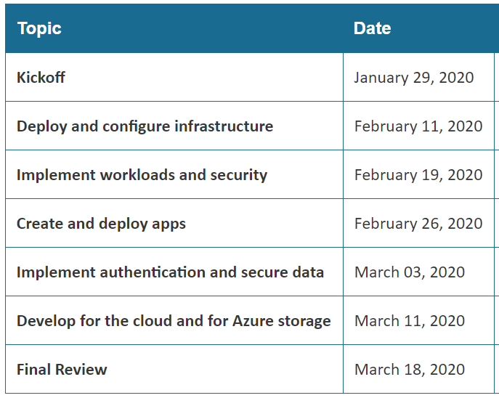
Series Agenda
Yammer: https://aka.ms/azurecsg
Homework:
https://aka.ms/AZ-300StudyGroup

Slide 5
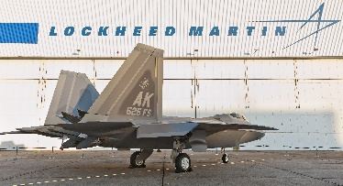
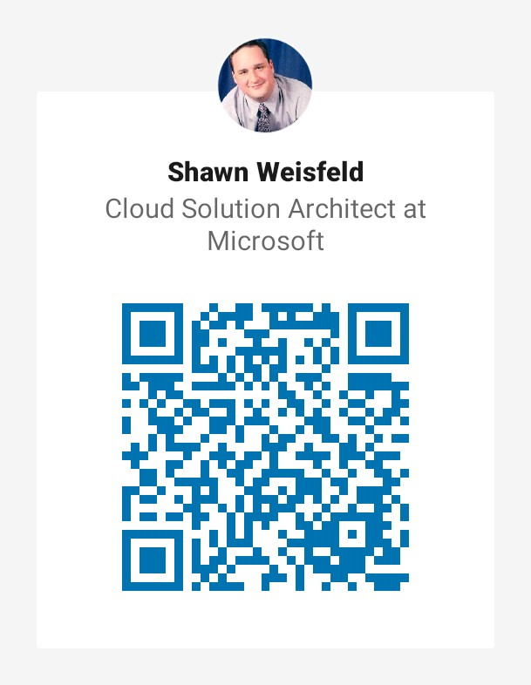

Slide 6
Feedback Loop

Slide 7
Configure a message-based integration architecture
configure an app or service to send emails
configure Event Grid
configure the Azure Relay service
create and configure a Notification Hub
create and configure an Event Hub
create and configure a Service Bus
configure queries across multiple products

Slide 8
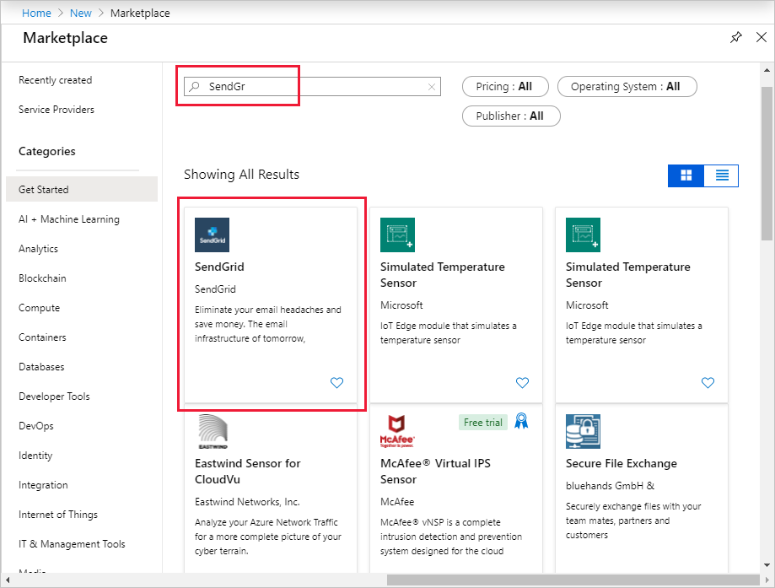
Send Email with SendGrid

Slide 9
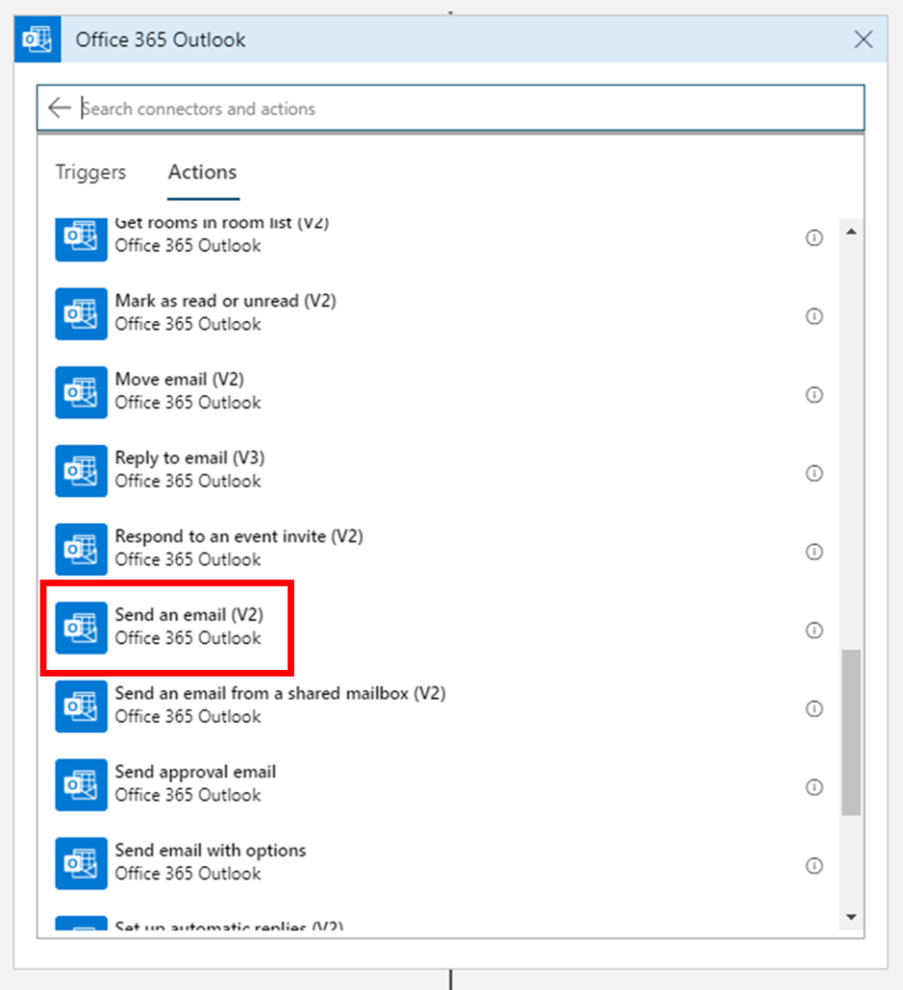
Send Email with Logic Apps

Slide 10
Messaging in Azure
Event Grid – reactive programming
Event Hub (IoT Hub) – big data pipeline
Kafka (HD Insight/Event Hub)
Service Bus – high value enterprise messaging
Storage Queues
From:
Implement workloads and security section

Slide 11
Azure Relay
Access on prem resources from Azure though the firewall.
Hybrid Connections - standard web sockets
WCF Relays - Windows Communication Foundation (WCF) - legacy

Slide 12
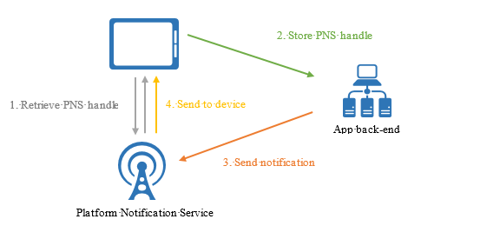
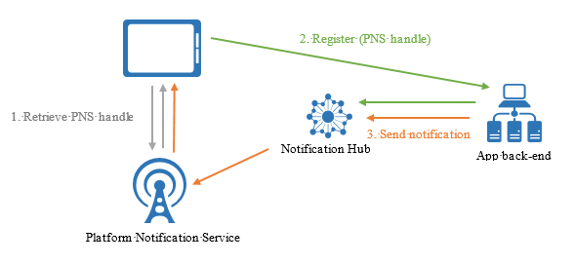
Notification Hub
Without Notification Hub
With Notification Hub

Slide 13
Develop for autoscaling
implement autoscaling rules and patterns (schedule, operational/system metrics)
implement code that addresses singleton application instances
implement code that addresses transient state

Slide 14
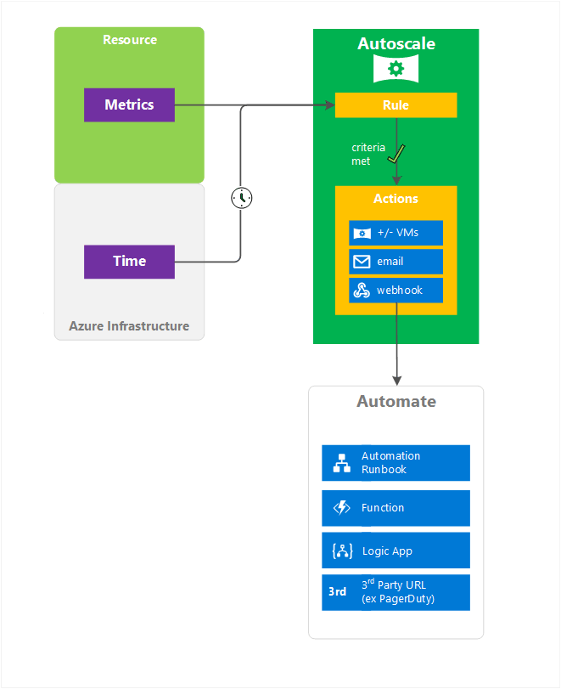
Autoscale
Prefer Horizontal over vertical scaling
Scaling options vary by target resource
Steps
Instrument/Monitor resource
Decide when to scale
Scale the system
Tune/monitor scaling

Slide 15
Scale Out
Avoid instance stickiness.
Identify bottlenecks.
Decompose workloads by scalability requirements.
Offload resource-intensive tasks.
Use built-in autoscaling features.
Consider aggressive autoscaling for critical workloads.
Design for scale in.

Slide 16
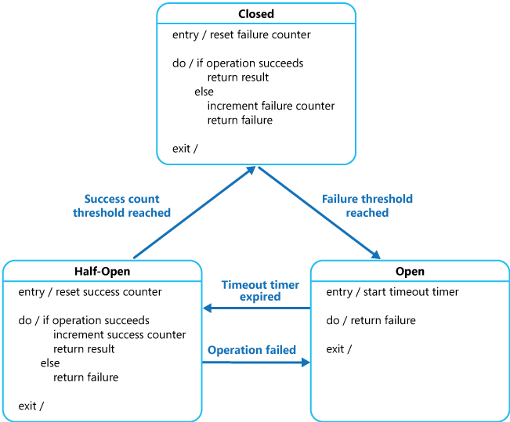
Transient State
Determine if there is a built-in retry mechanism
Determine if the operation is suitable for retrying
Determine an appropriate retry count and interval
Exponential back-off
Incremental intervals
Regular intervals
Immediate retry
Randomization

Slide 17
Develop solutions that use Cosmos DB storage
create, read, update, and delete data by using appropriate APIs
implement partitioning schemes
set the appropriate consistency level for operations

Slide 18
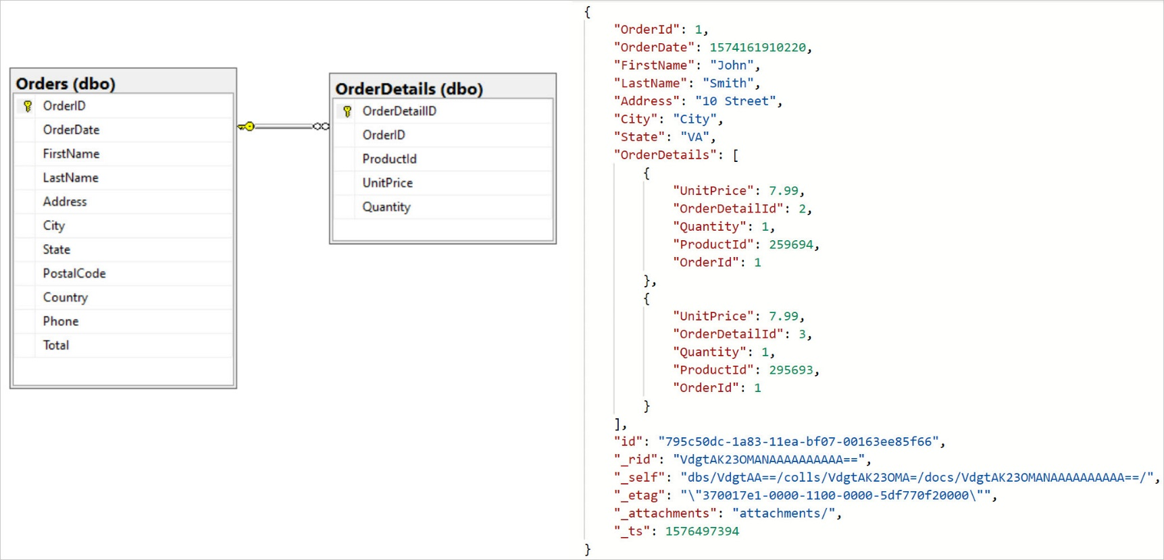
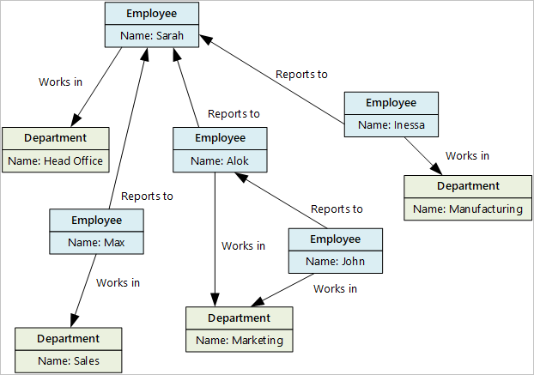
SQL vs NoSQL

Slide 19
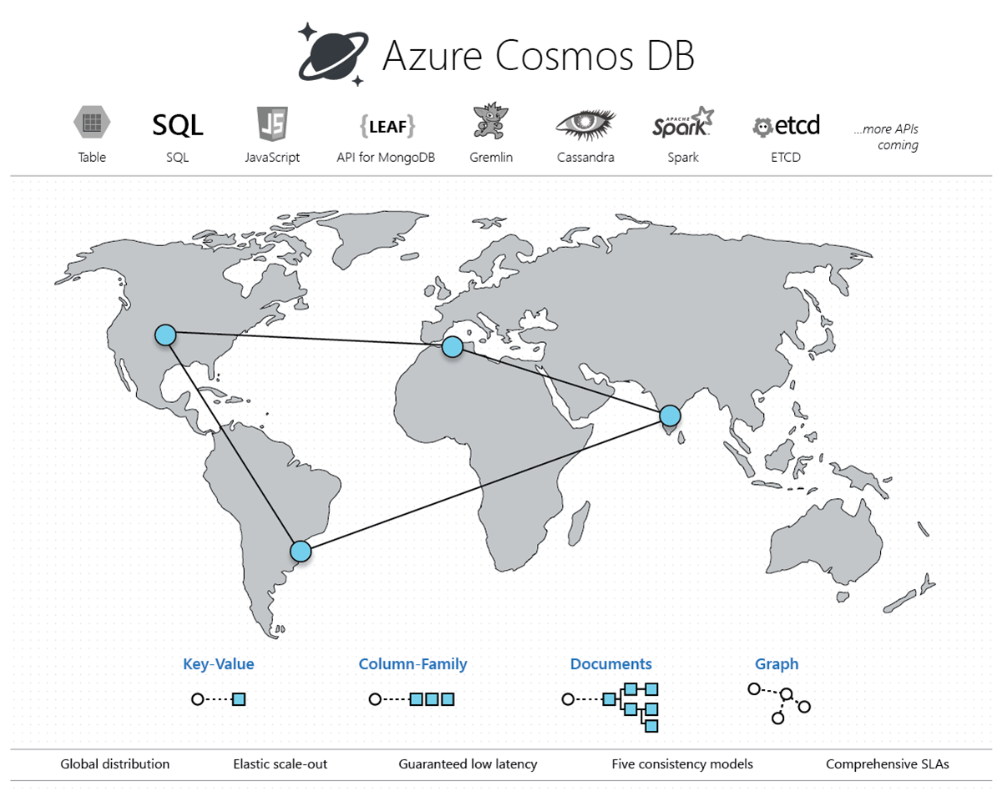
Azure Cosmos DB

Slide 20
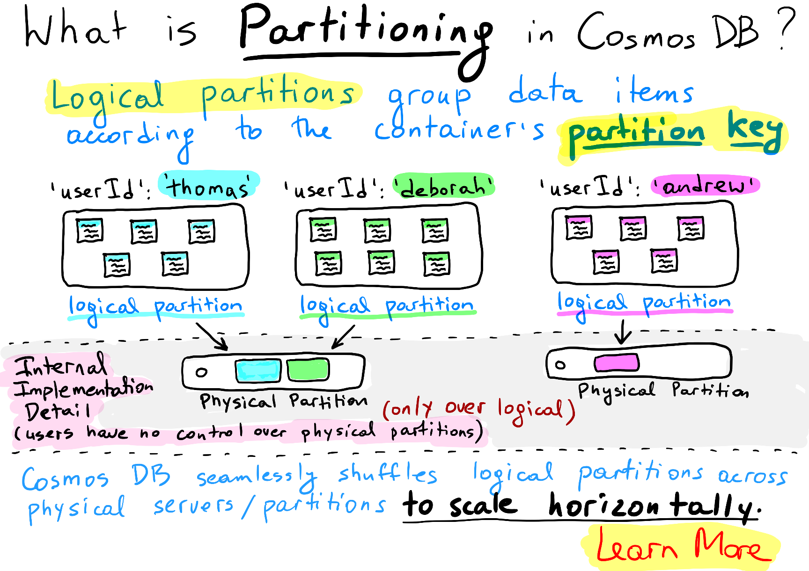
Partitioning in Azure Cosmos DB
Source: https://azurecosmosdb.github.io/CosmicNotes/

Slide 21
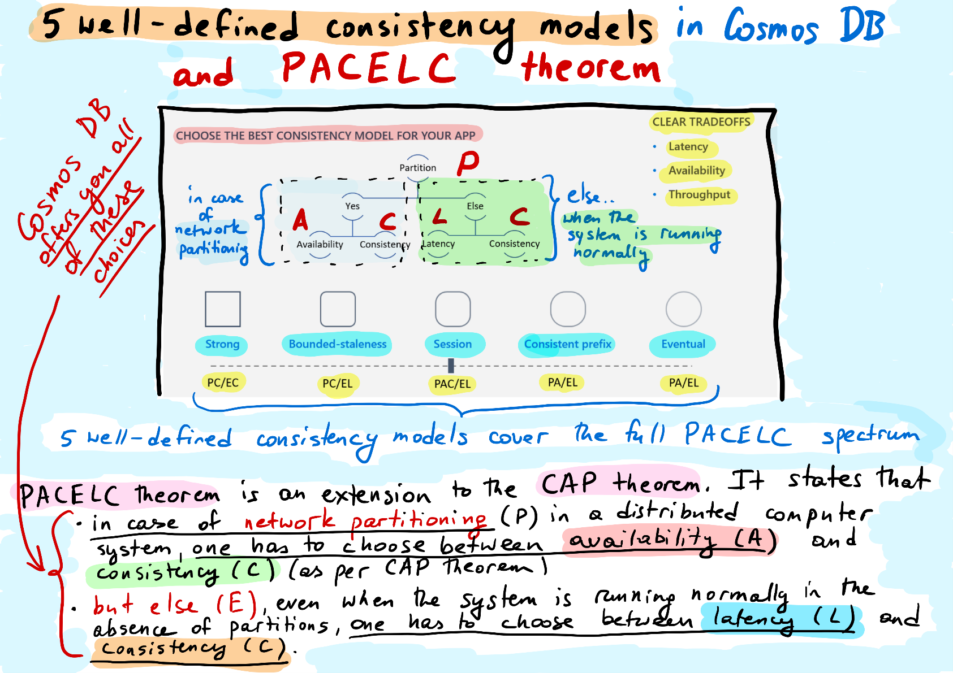
Consistency in Azure Cosmos DB
Source: https://azurecosmosdb.github.io/CosmicNotes/

Slide 22
Develop solutions that use a relational database
provision and configure relational databases
configure elastic pools for Azure SQL Database
implement Azure SQL Database managed instances
create, read, update, and delete data tables by using code

Slide 23
Relational Database Options

Slide 24
Questions?

Slide 25
Homework Assignment
https://aka.ms/AZ-300StudyGroup

Slide 26
Open Mic …

