Slide 1
Azure Study Group AZ-300 - Microsoft Azure Architect Technologies
Shawn Weisfeld
Cloud Solution Architect

Slide 2
Week 1 Deploy and configure infrastructure (40-45%)

Slide 3
Agenda
Agenda
1
Speaker Introduction
2
Feedback Loop
3
Objective Review
4
Open Mic
5

Slide 4
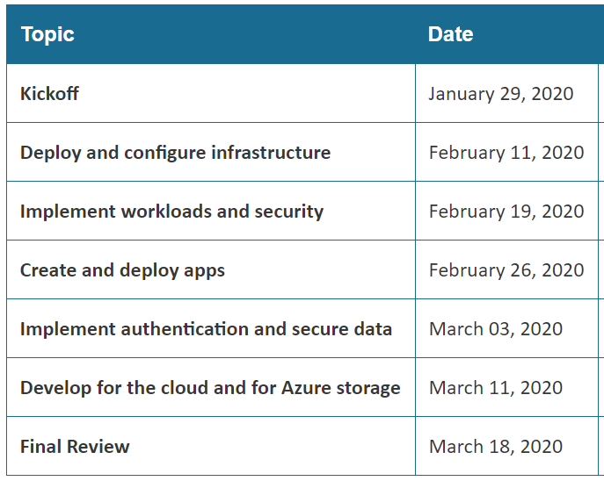
Series Agenda
Yammer: https://aka.ms/azurecsg
Homework:
https://aka.ms/AZ-300StudyGroup

Slide 5
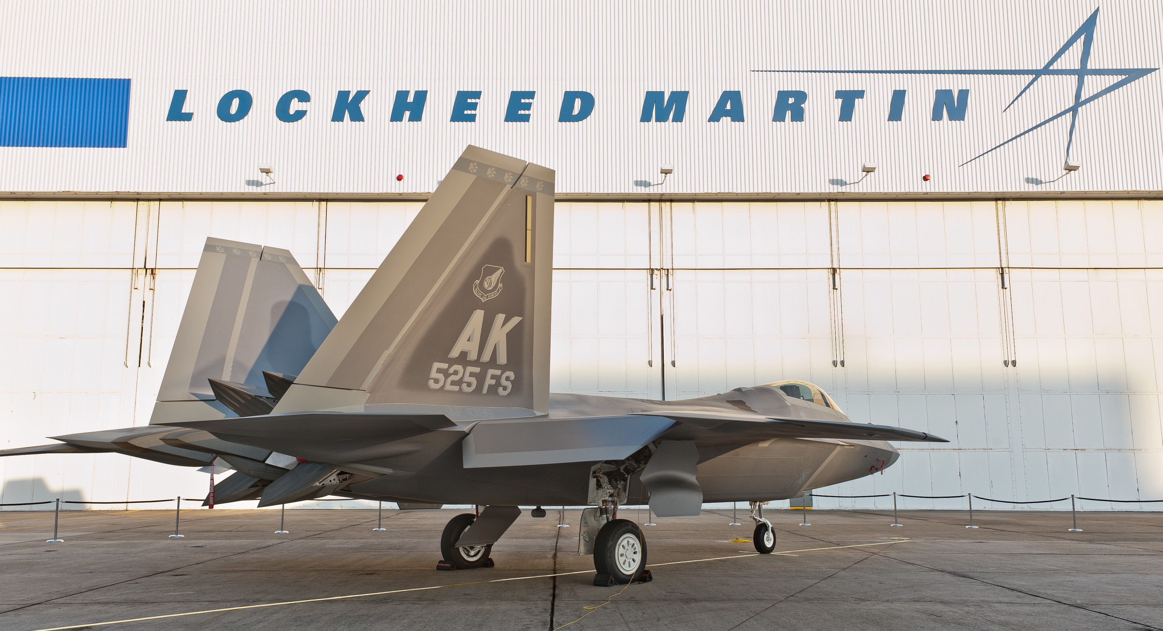
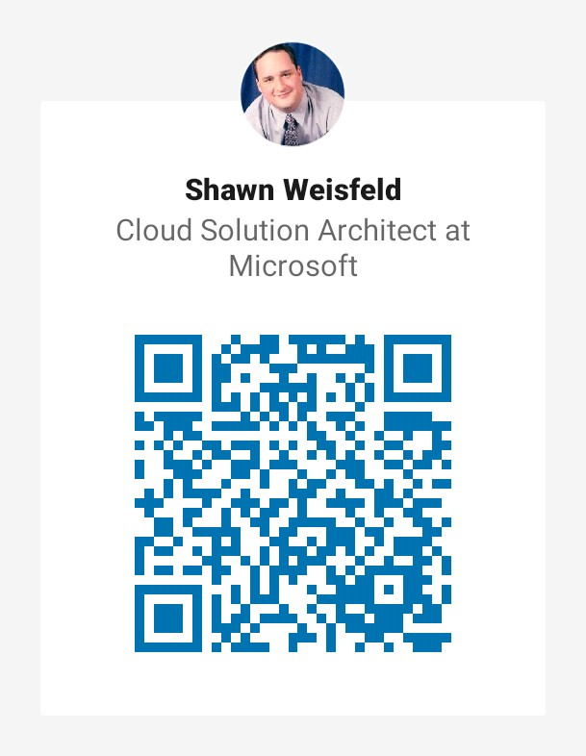
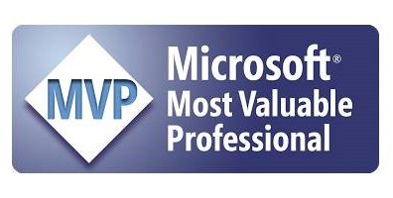

Slide 6
Feedback Loop

Slide 7
Analyze resource utilization and consumption
configure diagnostic settings on resources
create baseline for resources
create and test alerts
analyze alerts across subscription
analyze metrics across subscription
create action groups
monitor for unused resources
monitor spend
report on spend
utilize Log Search query functions
view alerts in Azure Monitor logs
visualize diagnostics data using Azure Monitor Workbooks

Slide 8
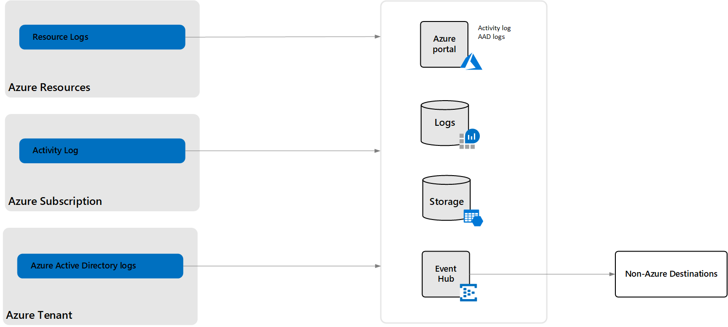
Azure Platform Logs

Slide 9
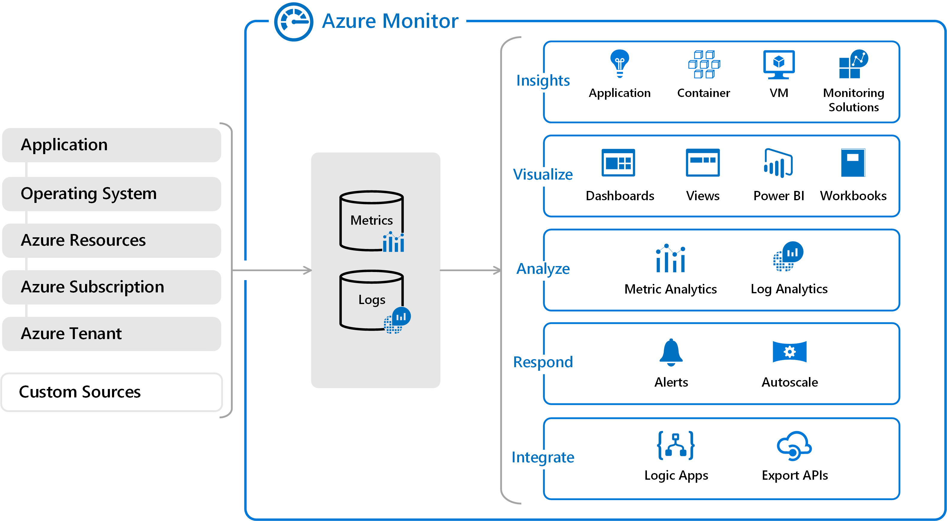
Azure Monitor

Slide 10
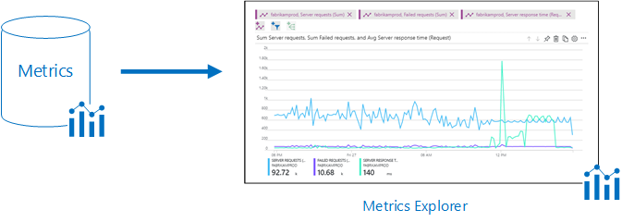
Metric Explorer

Slide 11
Azure Data Explorer

Slide 12
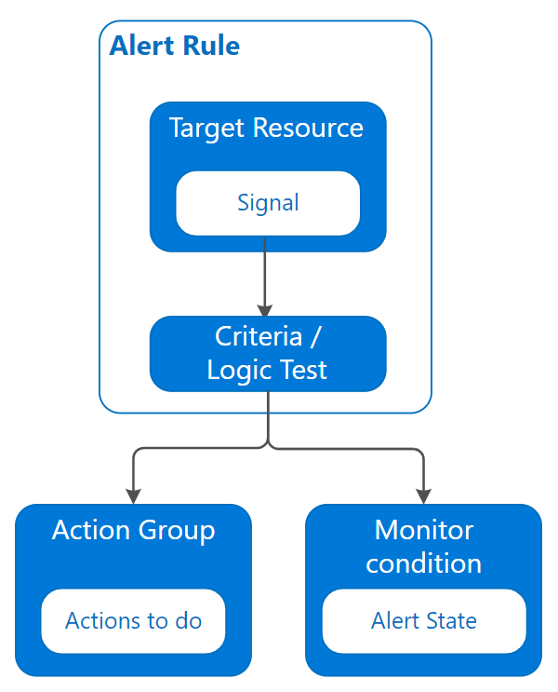
Alerts in Azure

Slide 13
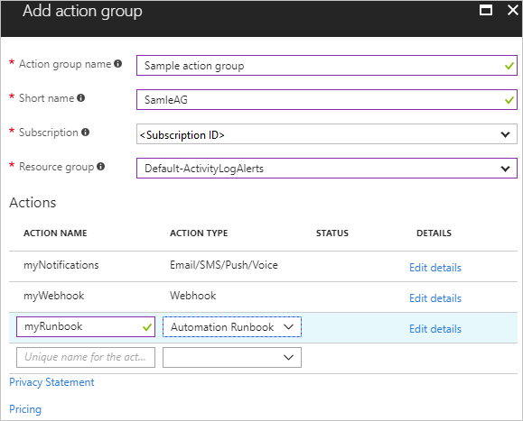
Action Group

Slide 14
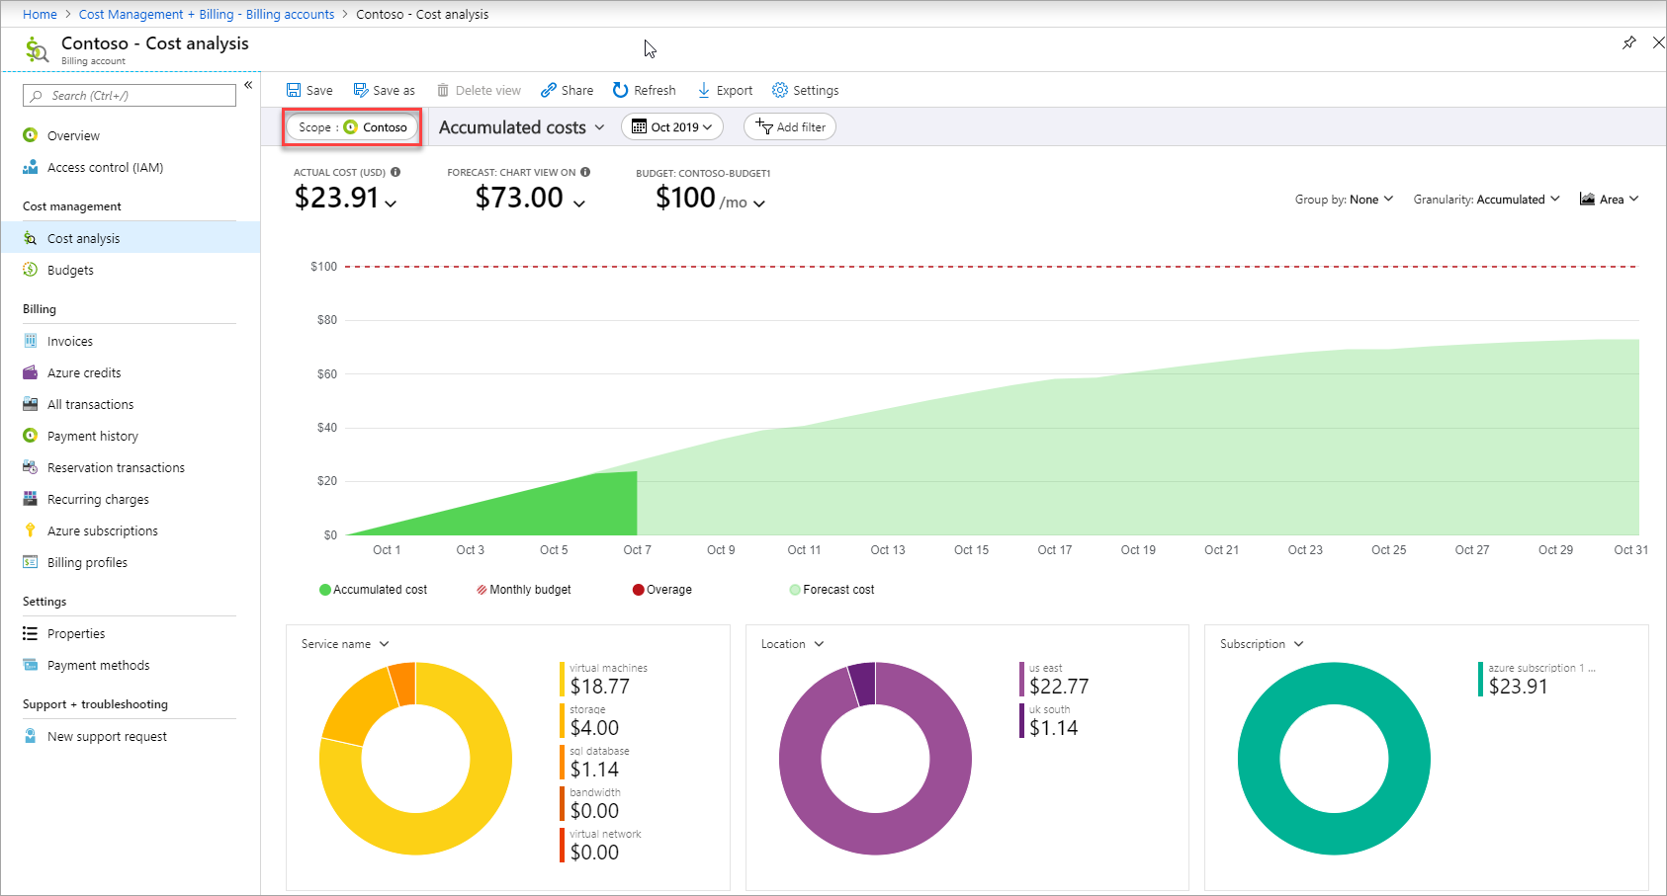
Cost Management + Billing page in the Azure portal

Slide 15
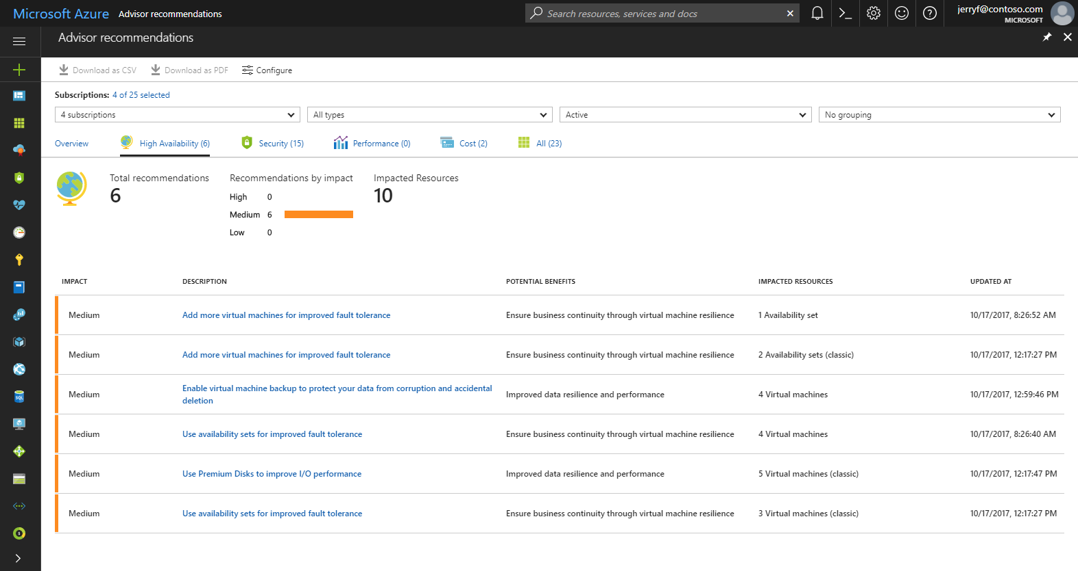
Azure Advisor

Slide 16
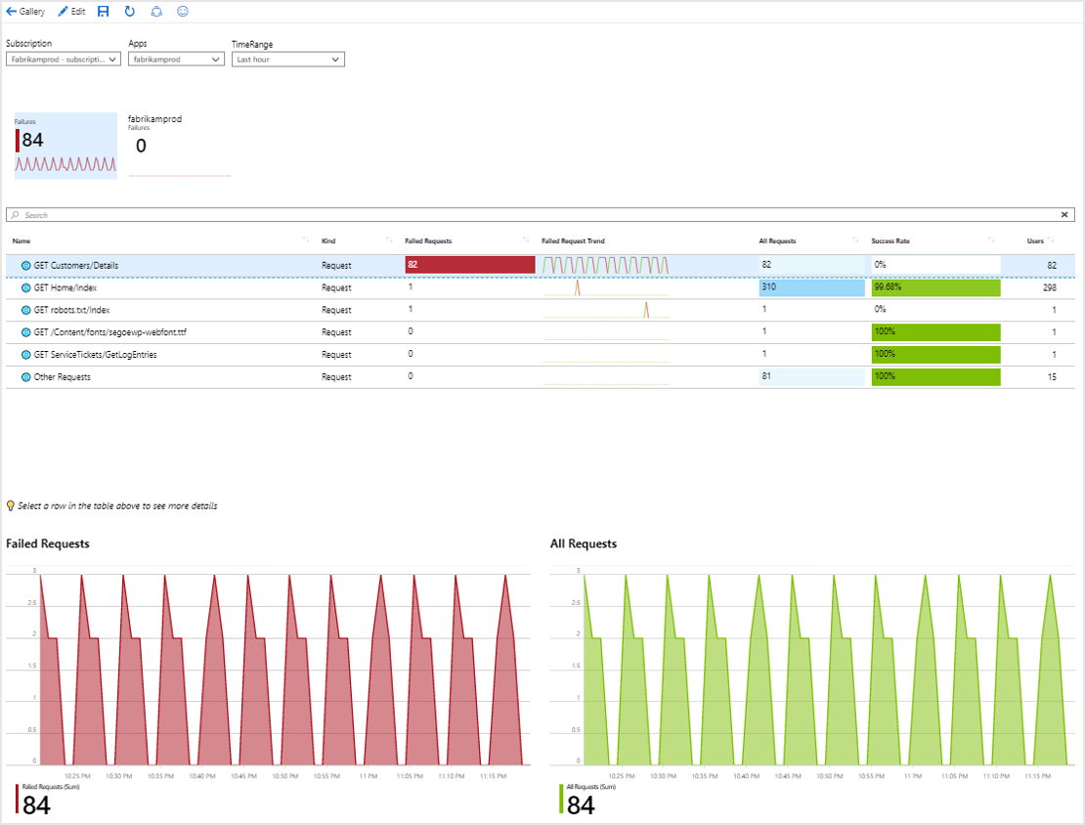
Azure Monitor Workbooks

Slide 17
Create and configure storage accounts
configure network access to the storage account create and configure storage account
generate shared access signature
implement Azure AD authentication for storage
install and use Azure Storage Explorer
manage access keys
monitor activity log by using Azure Monitor logs
implement Azure storage replication
implement Azure storage account failover

Slide 18
Share Access Signatures

Slide 19
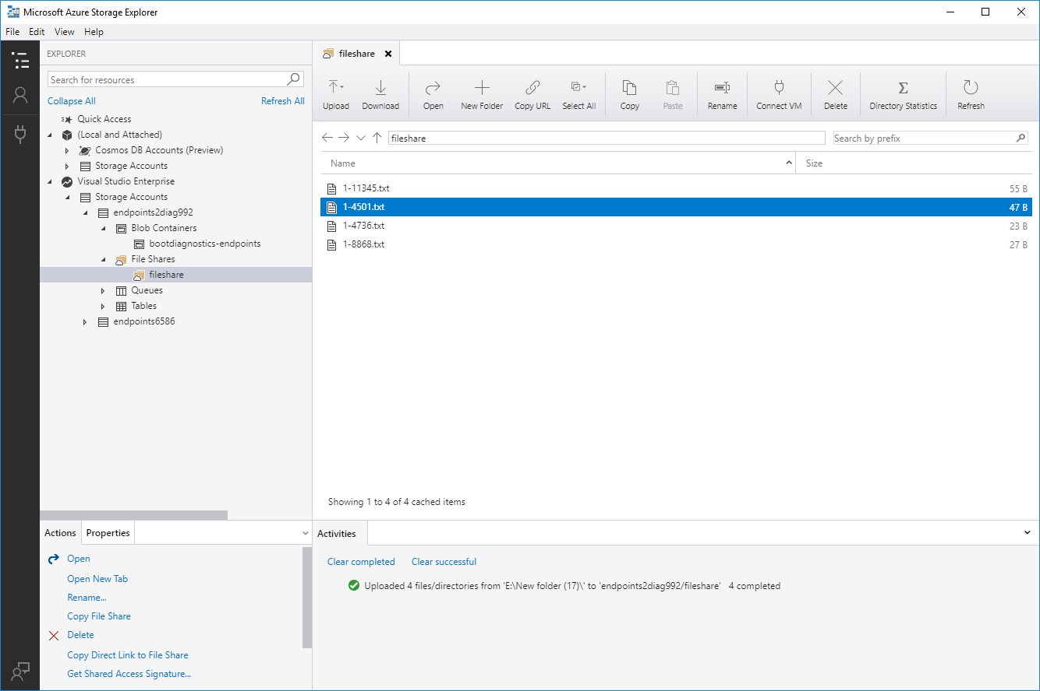
Azure Storage Explorer

Slide 20
Manage Storage Account Keys

Slide 21
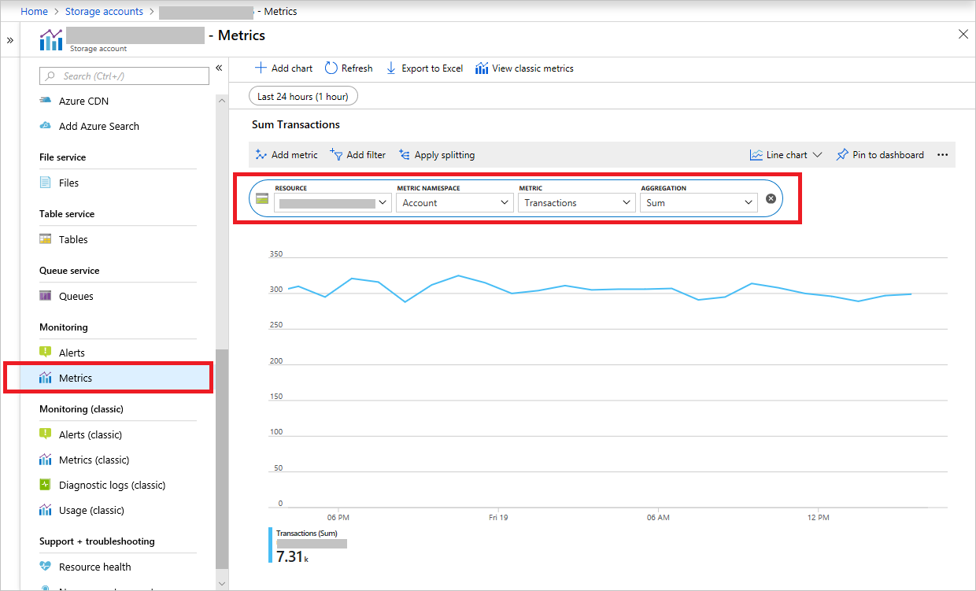
Access storage metrics in the Azure portal

Slide 22
Storage redundancy options
Locally redundant storage (LRS)
Zone-redundant storage (ZRS)
Geo-redundant storage (GRS)
Read-access geo-redundant storage (RA-GRS)
Geo-zone-redundant storage (GZRS)
Read-access geo-zone-redundant storage (RA-GZRS)

Slide 23
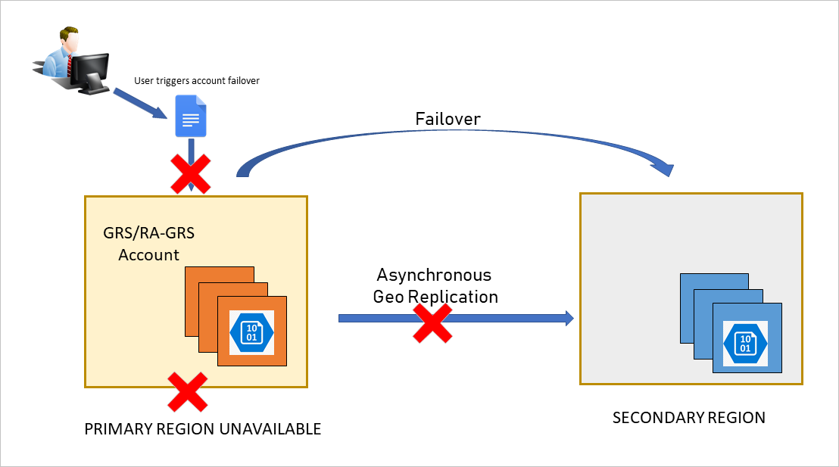
Storage account failover (preview)

Slide 24
Create and configure a VM for Windows and Linux
configure high availability
configure monitoring
configure networking
configure storage
configure virtual machine size
implement dedicated hosts
deploy and configure scale sets

Slide 25
Azure resiliency as a platform
Industry-leading high availability SLA
Power / facility
Region Pairs, Availability Zones, Availability Set
Industry-leading broadest choice of data residency
Industry-only
Industry-leading high availability SLA
VM SLA
VM SLA
VM SLA
Regions
99.9%
99.95%
99.99%
52
Data residency
Single VM
Availability sets
Availability zones
Region pairs
Protection with Premium Storage
Protection against failures within datacenters
Protection from entire datacenter failures
Protection from disaster with Data Residency compliance

Slide 26
Automate deployment of VMs
modify Azure Resource Manager template
configure location of new VMs
configure VHD template
deploy from template
save a deployment as an Azure Resource Manager template
deploy Windows and Linux VMs

Slide 27
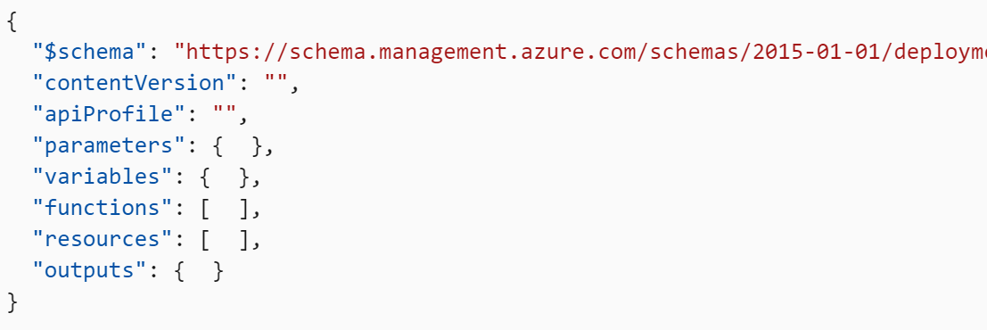
Azure Resource Manager templates

Slide 28
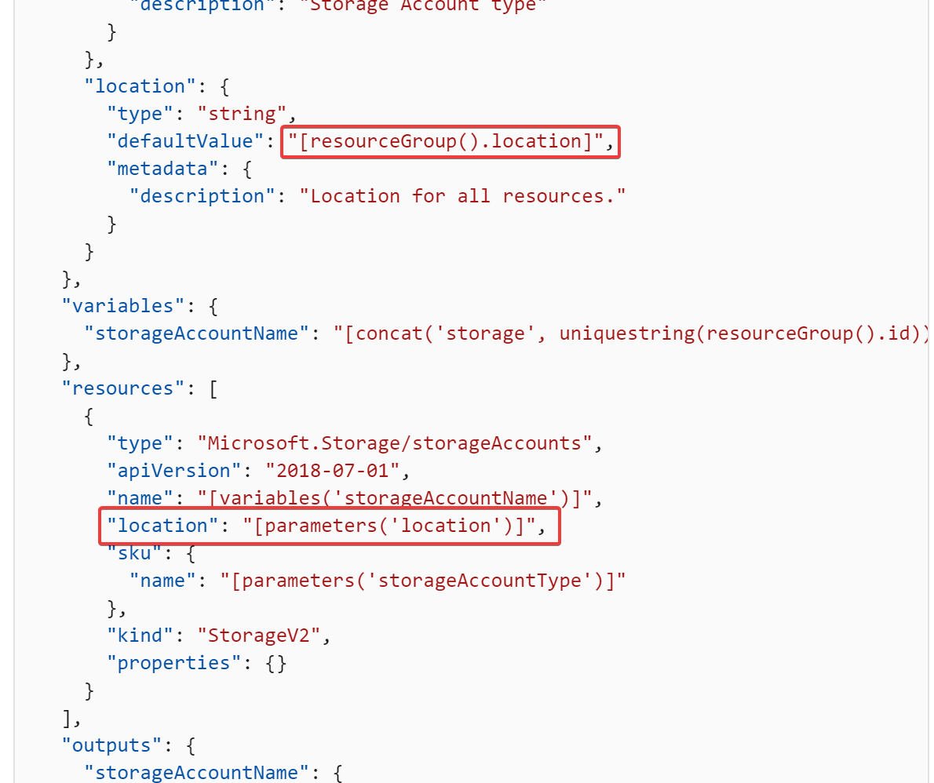
Setting locations in ARM

Slide 29
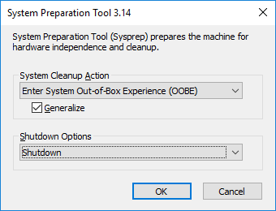
Generalize VMs to create VM template

Slide 30
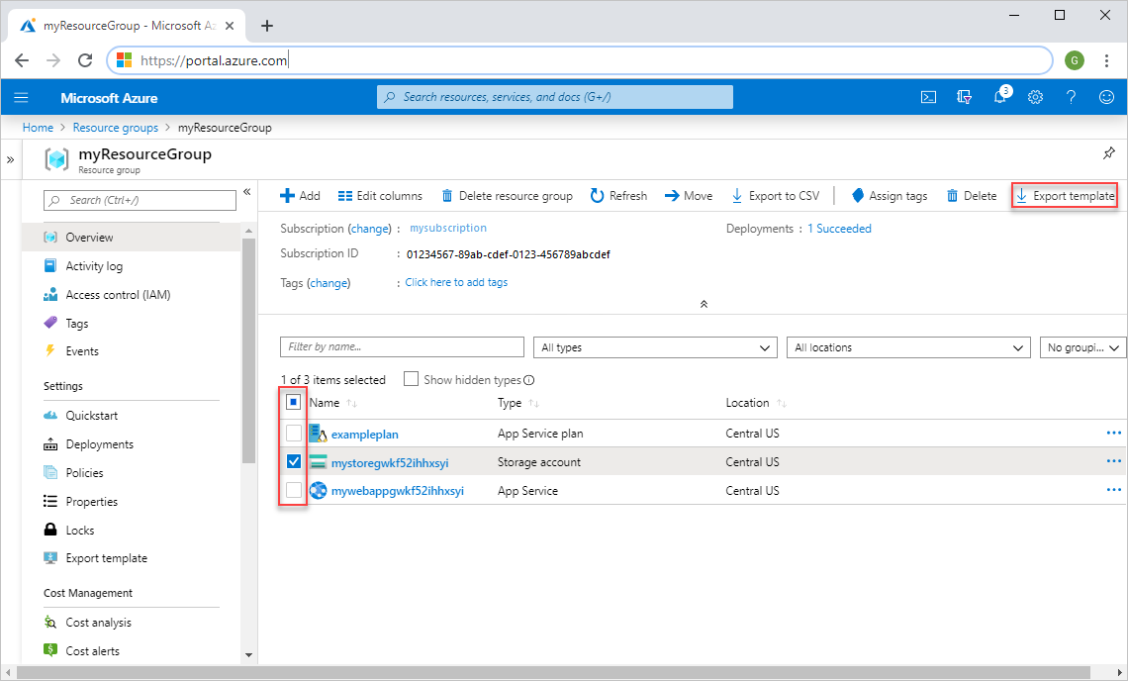
Export ARM Template from Azure Portal

Slide 31
Deploy Template from POSH
New-AzResourceGroup -Name $resourceGroupName -Location "$location"
New-AzResourceGroupDeployment `
-ResourceGroupName $resourceGroupName `
-TemplateUri "https://blah/azuredeploy.json" `
-adminUsername $adminUsername `
-adminPassword $adminPassword `
-dnsLabelPrefix $dnsLabelPrefix

Slide 32
Deploy template from CLI
az group create --name $resourceGroupName --location "$location"
az group deployment create --resource-group $resourceGroupName --template-uri https://blah/azuredeploy.json --parameters projectName=$projectName adminUsername=$username adminPublicKey="$key"

Slide 33
Create connectivity between virtual networks
create and configure Vnet peering
create and configure Vnet to Vnet connections
verify virtual network connectivity
create virtual network gateway

Slide 34
Vnet Gateway – site to site

Slide 35
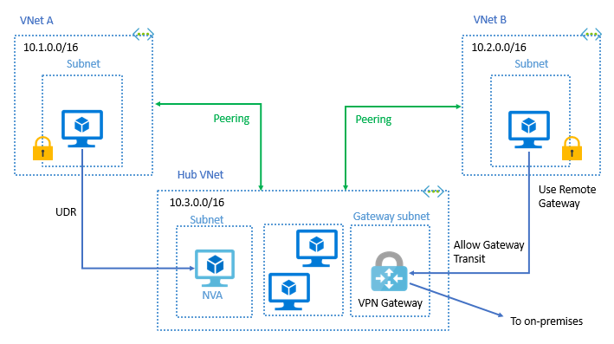
VNet Peering

Slide 36
Implement and manage virtual networking
configure private IP addressing
configure public IP addresses
create and configure network routes
create and configure network interface
create and configure subnets
create and configure virtual network
create and configure Network Security Groups and Application Security Groups

Slide 37
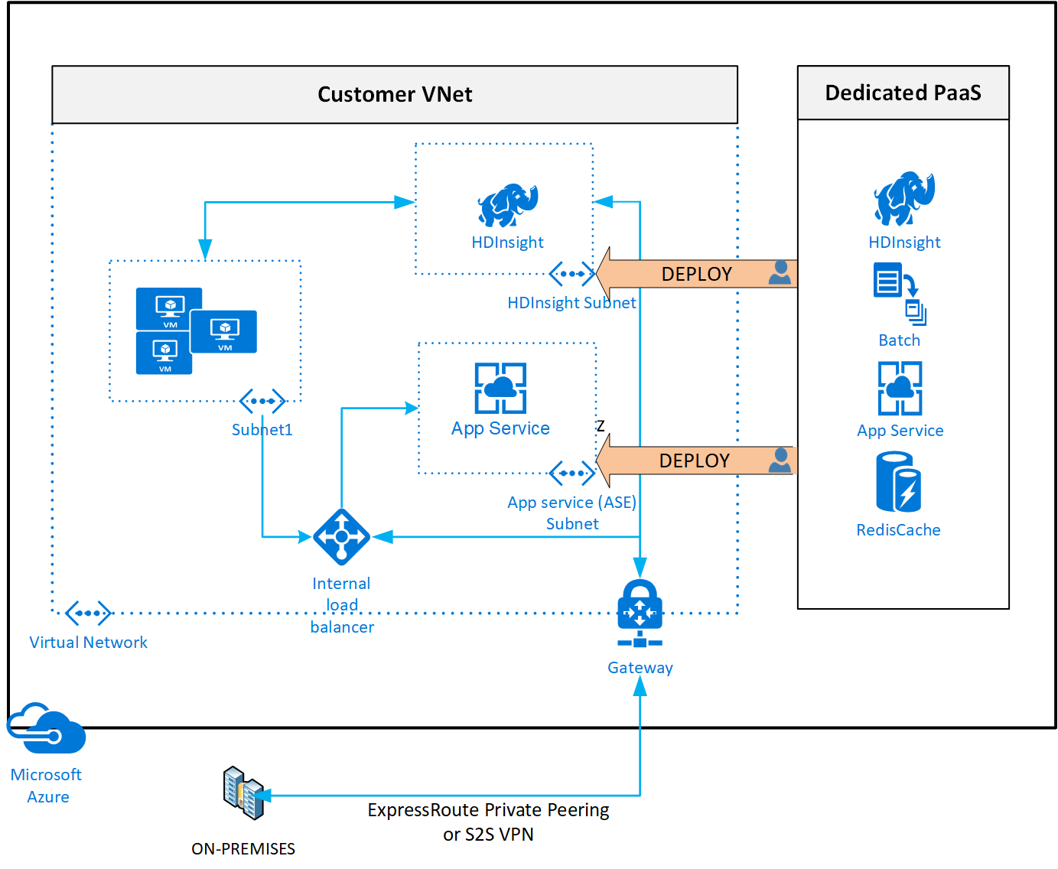
Example Virtual Network

Slide 38
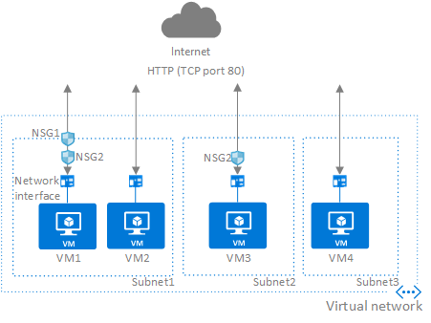
Network Security Groups

Slide 39
Manage Azure Active Directory
add custom domains
configure Azure AD Identity Protection
configure Azure AD Join
configure self-service password reset
implement conditional access policies
manage multiple directories
perform an access review

Slide 40
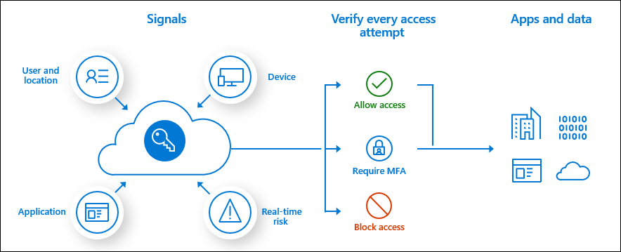
Conditional Access

Slide 41
Implement and manage hybrid identities
install and configure Azure AD Connect
configure federation
configure single sign-on
manage and troubleshoot Azure AD Connect
troubleshoot password sync and writeback

Slide 42
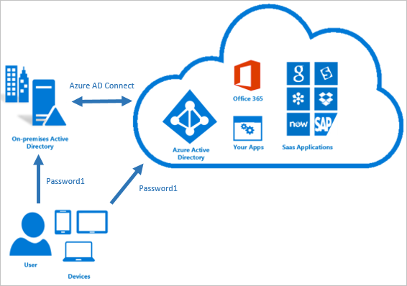
Azure AD Connect

Slide 43
Implement solutions that use virtual machines (VM)
provision VMs
create Azure Resource Manager templates
configure Azure Disk Encryption for VMs
implement Azure Backup for VMs

Slide 44
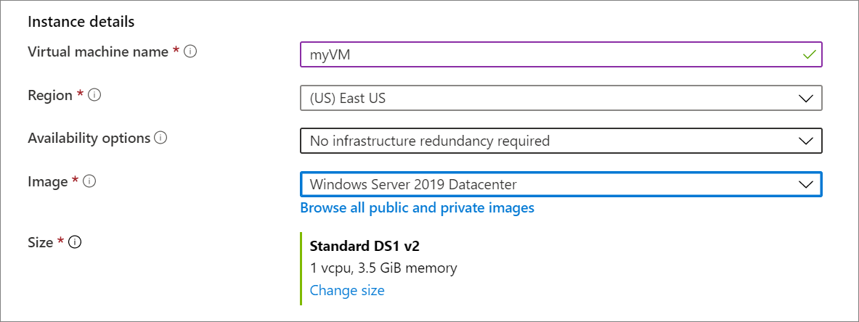
Create VMs in the portal

Slide 45
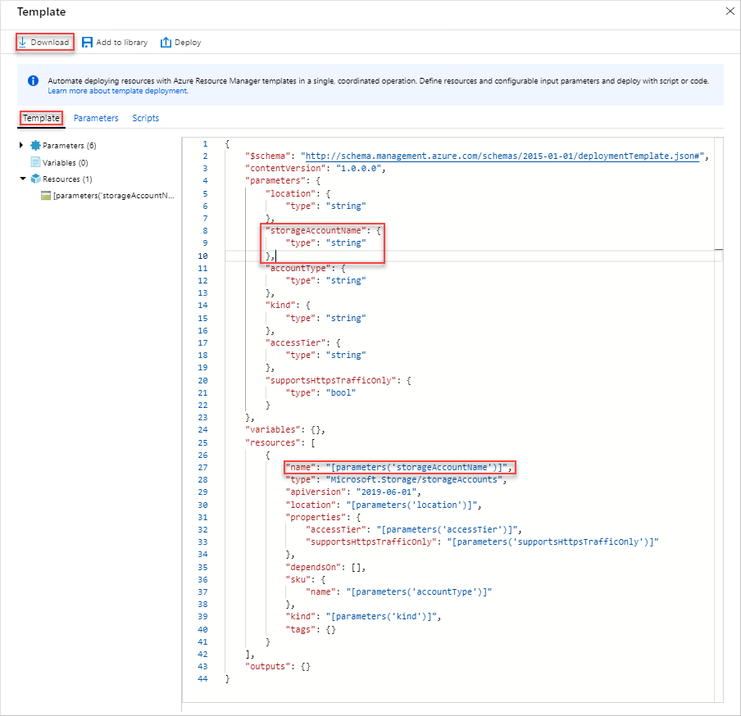
Export ARM template from the portal

Slide 46
Deploy Template from the portal

Slide 47
Encrypt VM with Azure CLI
az group create --name myResourceGroup --location eastus
az vm create --resource-group myResourceGroup --name myVM --image win2016datacenter --admin-username azureuser --admin-password myPassword12
az keyvault create --name "myKV" --resource-group "myResourceGroup" --location eastus --enabled-for-disk-encryption
az vm encryption enable -g MyResourceGroup --name MyVM --disk-encryption-keyvault myKV

Slide 48
Questions?

Slide 49
Homework Assignment
https://aka.ms/AZ-300StudyGroup

Slide 50
Open Mic …

